Slide 1








[Episode.3]
Fire-fighting
& Safety
Systems in Korea
Disabled
Woman
Elderly
Foreigner

Slide 2



Contents
[Episode.3 ]
Fire-fighting & Safety Systems in Korea
1. Alarming Equipment_ 2p
2. Fire-fighting Equipment_ 5p
3. Fire Grade K_ 8p
4. Escape Equipment_ 9p
Disabled
Woman
Elderly
Foreigner

Slide 3


1
Alarming Equipment
“
Fire-fighting systems – alarming equipment, escape equipment, fire-fighting equipment
If you know and understand how the fire protection system, the fire alarm and fire fighting equipment work, it will be very helpful if a fire occurs
“
Disabled
Woman
Elderly
Foreigner

Slide 4
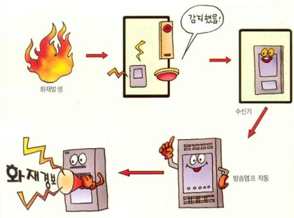
1
Alarming Equipment
Fire alarm is the fastest fire notification device when a fire occurs
Detected
Fire occurs
Receiving set
Broadcasting
amplifier work
Fire alarm
The sensor installed on the ceiling automatically senses heat and smoke and then emits an alarming signal
Disabled
Woman
Elderly
Foreigner

Slide 5
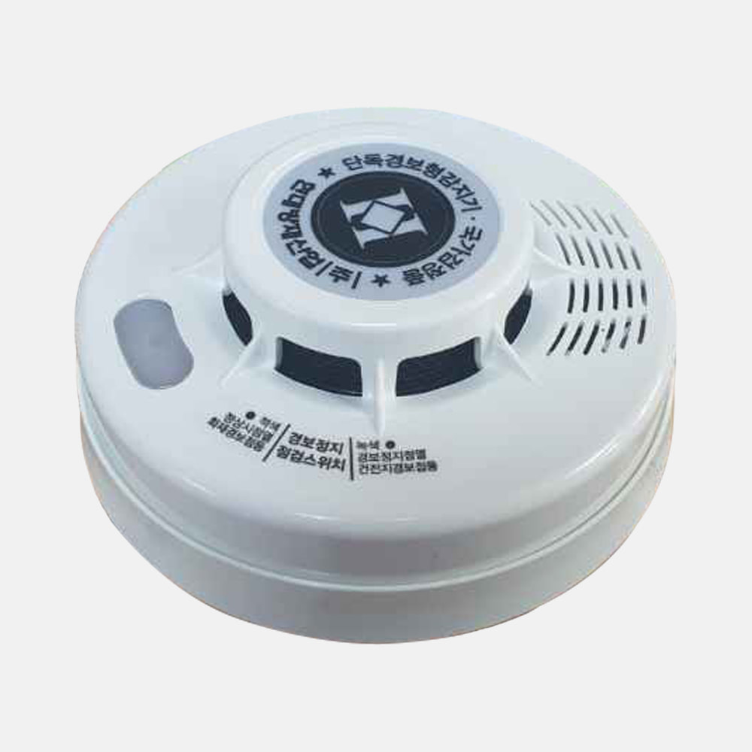
1
Alarming Equipment
Independent sensor signaling device
The machine uses 9V battery that does not need to connect to the power source, emits a "Bbi Bbi" sound to alert and instruct people to exit.
The device is mounted on the ceiling and fire detectors can press the button manually to notify a fire
Disabled
Woman
Elderly
Foreigner

Slide 6
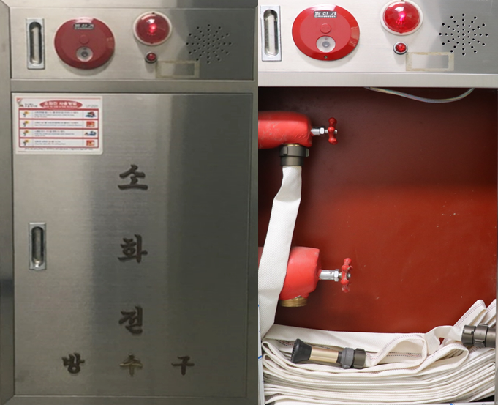
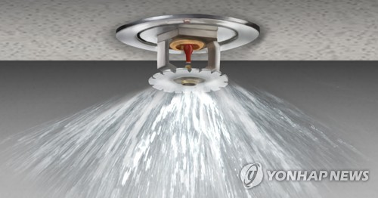
2
Fire-fighting Equipment
Fire hydrant
Fire hydrant is installed on the wall in a building or apartment building. Long water pipes are connected to the water tank. One just turn the tube and the water will gush out to extinguish fire
Sprinkler
Automatic fire sprinkler is usually installed on the ceiling with sensors
Disabled
Woman
Elderly
Foreigner

Slide 7
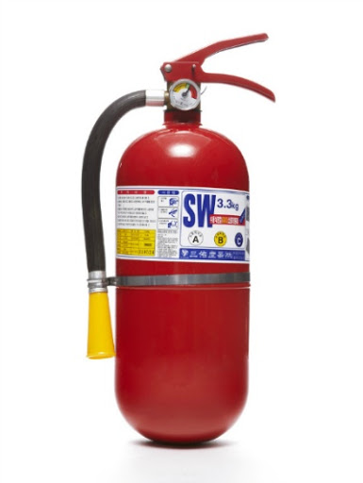
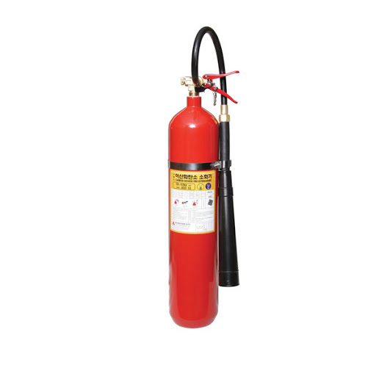
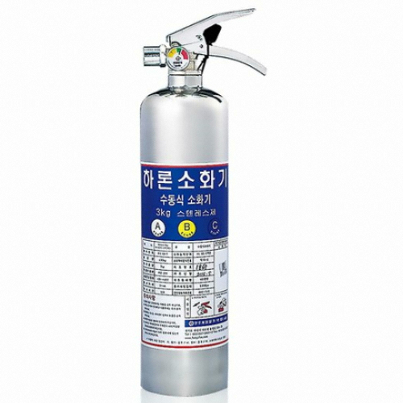
2
Fire-fighting Equipment
Fire extinguisher is a one-man device used to extinguish a fire
when there is a small or newly discovered fire
Powder fire extinguisher
Carbon dioxin fire extinguisher
Halon fire extinguisher
Disabled
Woman
Elderly
Foreigner

Slide 8
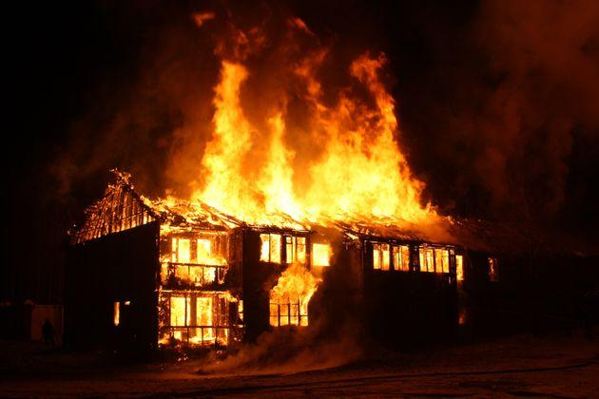
2
Fire-fighting Equipment
Use suitable fire extinguishers for each type of fire
Grade A
Fire from objects such as tables, clothes, books, trees, cloth, paper, etc.
Grade B
Fire by gas or oil
Grade C
Fire from electronic devices such as TVs, transformers, etc.
A fire extinguisher class A, B, C can extinguish all types of fire above
Disabled
Woman
Elderly
Foreigner

Slide 9
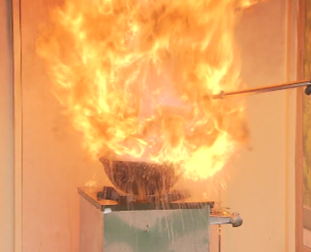
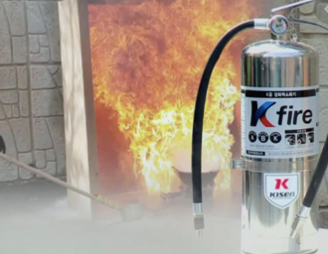
3
Fire Grade K
What is a fire grade K?
A fire caused by cooking tools using animal or vegetable cooking oil in a kitchen or food processing facilities
In the kitchen, it is necessary to use grade K fire-fighting equipment
Disabled
Woman
Elderly
Foreigner

Slide 10
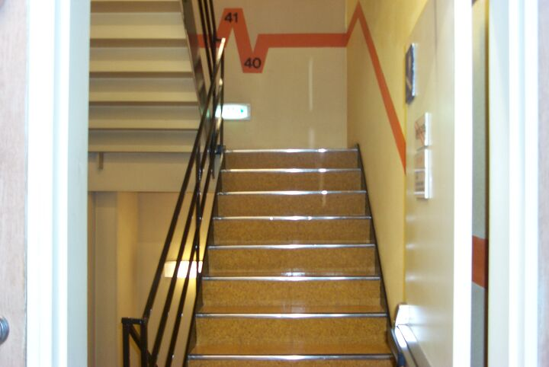
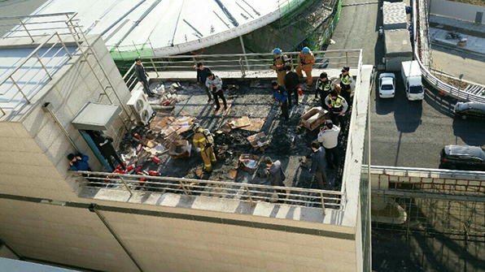
4
Escape Equipment
Exit system - Exit tools and equipment
1. The emergency staircase
Stairs are built in the building for escape purpose
Do not leave items on the stairs that might prevent the escape of others
2. The terrace
Used as a temporary escape location on the upper floor
Disabled
Woman
Elderly
Foreigner

Slide 11
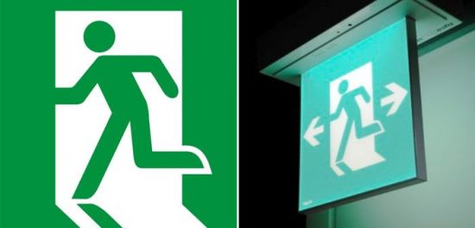
4
Escape Equipment
Exit signal lights
Lights indicate exit when an accident or fire occurs
Even surrounded by a lot of smoke, the lights can still be clearly seen to indicate the exit
Lights are installed at 1 meter high from the stairs or landings to be able to be seen clearly
Disabled
Woman
Elderly
Foreigner

Slide 12

*
Key Points for Fire Safety
“
The fire fighting system needed in fire prevention
and initial reaction!
One should know and understand the nature of fire fighting systems such as alarming equipment,
fire-fighting equipment and escape equipment.
“
Disabled
Woman
Elderly
Foreigner

Slide 13

Fire-fighting & Safety Systems in Korea
Fire safety training is the foundation for a safe society and happy people

