Slide 1








[Epizod.6]
Benzin yong'inlari xavfi
va xavfsizlik qoidalari
Nogiron
Ayol
Katta
Chet ellik

Slide 2



Contents
[Epizod.6]
Benzin yong'inlari xavfi va xavfsizlik qoidalari
Benzin yong'inlari statistikasi _ 2p
Yoqilg'i isitgichi xavfi_ 4p
Oilada benzin uchun xavfsizlik qoidalari _ 6p
Nogiron
Ayol
Katta
Chet ellik

Slide 3


1
Benzin yong'inlari statistikasi
“
At 11am on October 7, 2019
At Goyang petrol station in Goyang province
The fuel tank exploded, causing a major fire
The fire spread widely and caused anxiety in the public (property damage of 4.3 billion won, no casualties)
So let's analyze the petrol fire as well as the regulations on petrol safety.
“
Nogiron
Ayol
Katta
Chet ellik

Slide 4
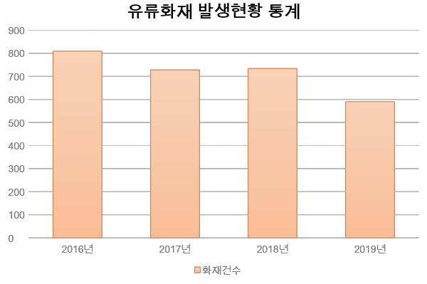
1
Benzin yong'inlari statistikasi
Statistics on the Occurrence of Oil fires
2016
2017
2018
2019
The Number of Fires
National Fire Data System(www.firedata.go.kr), Statistics on the Occurrence of Oil fires
Nogiron
Ayol
Katta
Chet ellik

Slide 5
1
Benzin yong'inlari statistikasi
In a fire caused by a gasoline in Suwon, three people suffered severe burns
Use of a petrol heater caused fire at a restaurant
At a restaurant in the Kwon Son district of Suwon city, a fire broke out and it took 20 minutes for the fire to be extinguished.
The fire resulted in three people injured all over their bodies and legs and immediately taken to the hospital
News 2019.1.14.
At a restaurant in SeongNam province, a petrol heater killed a 50-year-old woman.
The reason for the fire is that the store has opened the petrol heater that caused the fire to ignite the oil.
MBC 2018.3.27.
Nogiron
Ayol
Katta
Chet ellik

Slide 6
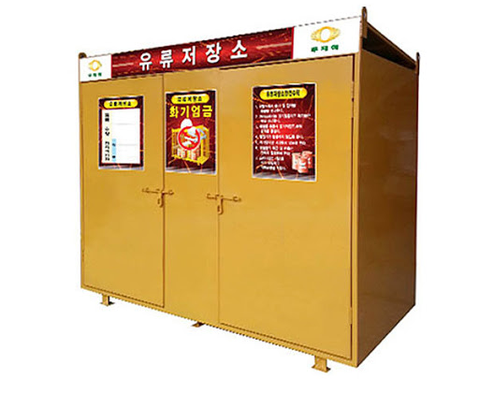
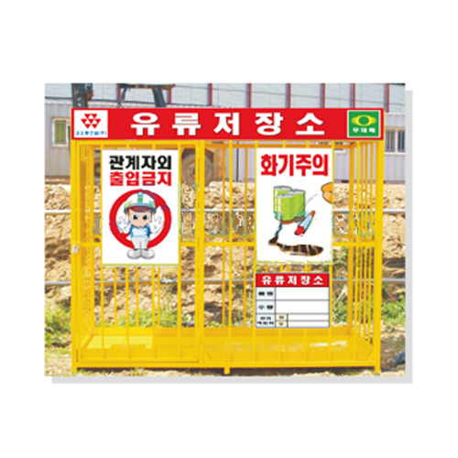
1
Yoqilg'i isitgichi xavfi
2
Benzinli isitgichdan xavfsiz foydalaning
Suv hisoblagichidan foydalanishdan oldin uning ichida benzin bor-yo'qligini tekshirib ko'ring. Yonuvchan narsalarning mavjudligini tekshiring
Olovni ishlatish paytida qurilma qizib ketmasligi uchun sozlang. Dvigatel qizib ketmasligi uchun tez-tez tekshirib turing va dvigatelni o'chiring va yonilg'i quyishdan oldin issiqni sovishini kuting.
Nogiron
Ayol
Katta
Chet ellik

Slide 7
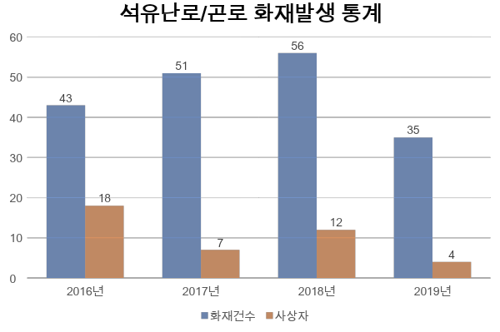
2
Yoqilg'i isitgichi xavfi
Yoqilg'i isitgichi, Yog 'pechkasi olovning paydo bo'lishi statistikasi
2016
2017
2018
2019
2016 yil
2017 yil
2018 yil
2019 yil
Yong'inlar
soni
Baxtsiz hodisalar
Milliy yong'in ma'lumotlari tizimi(www.nfds.go.kr)Yoqilg'i isitgichi, yog 'pechkasi Yong'in paydo bo'lishi statistikasi
Nogiron
Ayol
Katta
Chet ellik

Slide 8
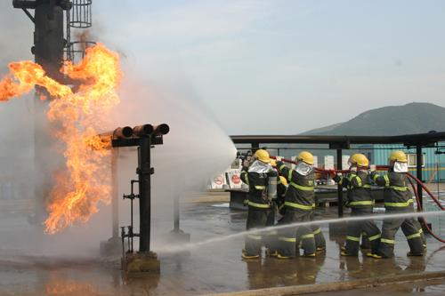
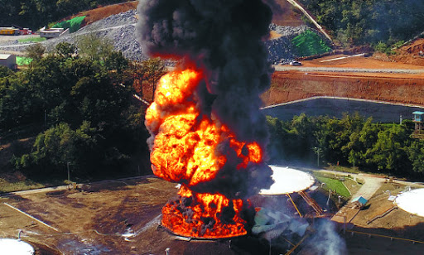
3
Oilada benzin uchun xavfsizlik qoidalari
Yoqilg'i isitgichi kabi benzin bilan ishlaydigan asboblarni uzoq vaqt yoqishda ehtiyot bo'lish kerak, chunki ular portlashga olib kelishi mumkin.
Qurilmalarning quvvatini o'chirish yong'inning sababi va olovni o'chirishdir, hech qanday holatda ham olovni o'chirish uchun suvdan foydalanmang.
Nogiron
Ayol
Katta
Chet ellik

Slide 9

*
Yong'in xavfsizligi uchun asosiy nuqta
“
Benzindan kelib chiqqan yong'in ko'pincha katta olovdir, chunki benzin zarralari chang zarralari kabi havoga tarqaladi va osongina tarqaladi.
Benzin bilan bog'liq asboblar va moslamalarni ishlatishda xavfsizlik qoidalari va ko'rsatmalariga rioya qiling
“
Nogiron
Ayol
Katta
Chet ellik

Slide 10

Benzin yong'inlari xavfi va xavfsizlik qoidalari
Yong'in xavfsizligini o’rganish xavfsiz jamiyat va baxtli odamlarning asosidir

