Slide 1


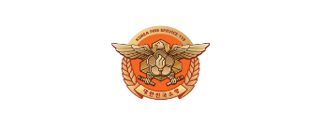





[Episode.1]
Role of Fire
Departments
Disabled
Woman
Elderly
Foreigner

Slide 2



Contents
[Episode.1]
Role of Fire Departments
1. Function & Mission of Fire Departments_ 2p
2. Fire Prevention and Fire-fighting_ 3p
3. Rescue, EMS & Life Safety _ 5p
4. Procedure of 119 Reporting System_ 6p
Disabled
Woman
Elderly
Foreigner

Slide 3

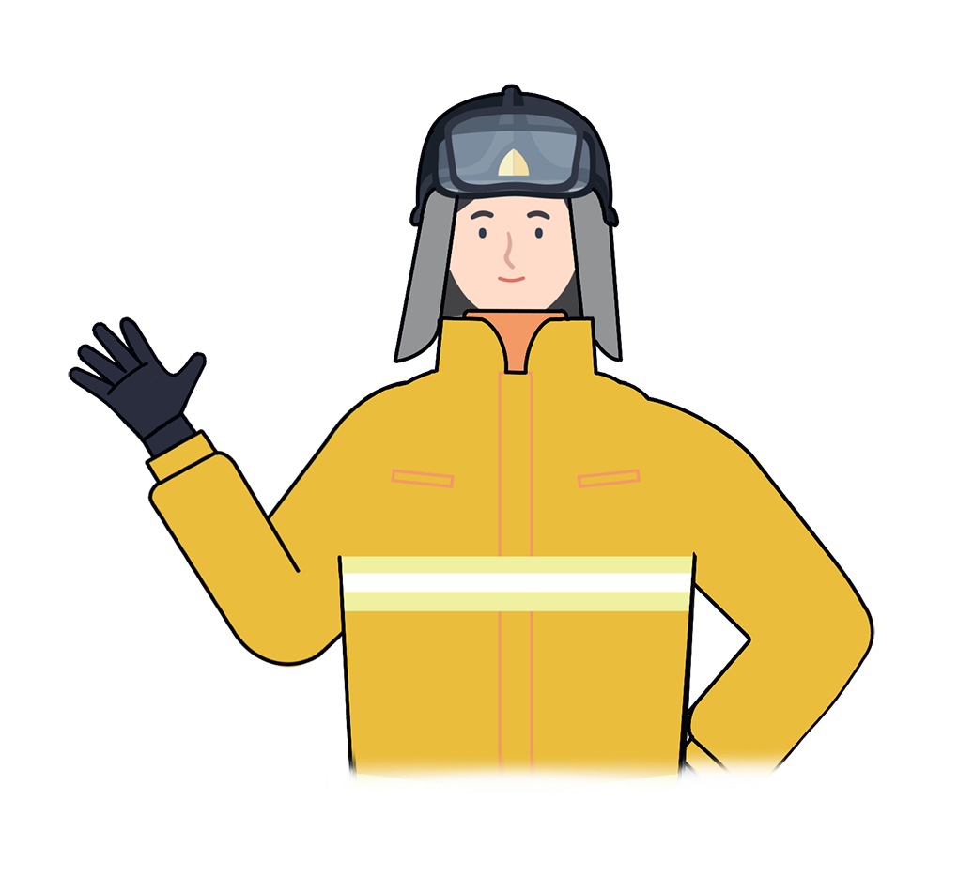
Function & Mission of Fire Departments
1
“
The fire service organization plays key roles for the safety of the nation
Composed of highly trained professional fire officials with state of the art fire, rescue and EMS equipments
Always try our best to provide quick and accurate rescue plans to respond to each type of accidents, natural disasters to ensure the safety of the people and the nation
“
Disabled
Woman
Elderly
Foreigner

Slide 4
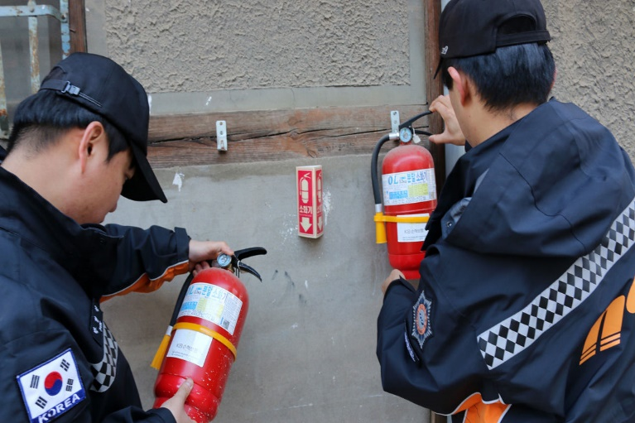
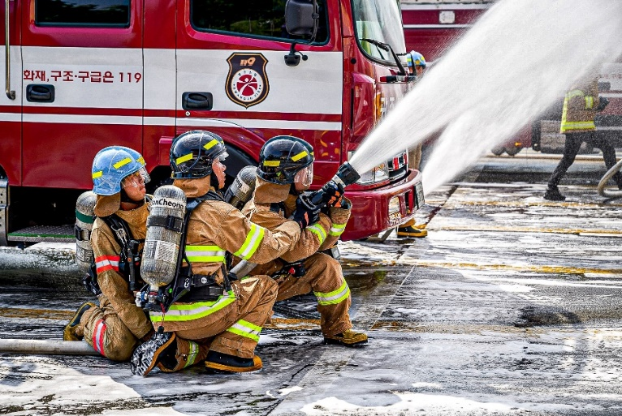
2
Fire Prevention and Fire-fighting
Fire Prevention
Fire prevention
- Promote and educate about fire accidents
- Check and inspect fire facilities
- Operate Fire prevention activities
Fire Fighting
Fire fighting
- Respond to all kinds of fire accidents
- Highly trained human resources with modernized
fire and rescue equipments
Disabled
Woman
Elderly
Foreigner

Slide 5
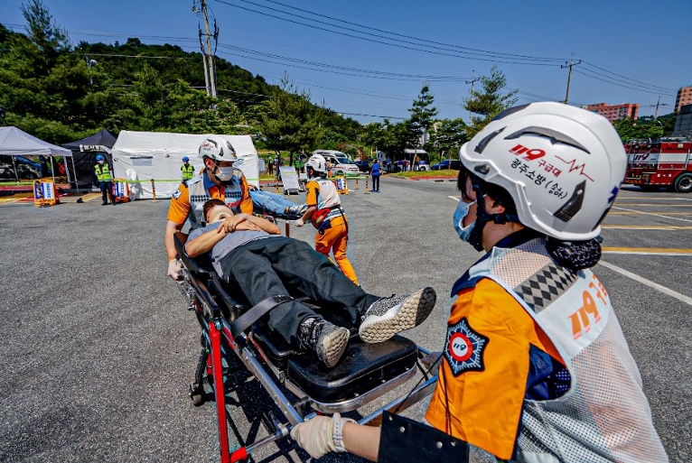
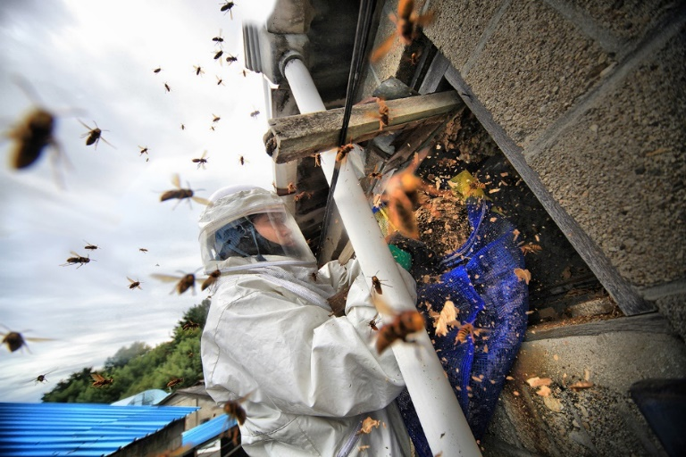
3
Rescue, EMS & Life Safety
Rescue & EMS
Emergency Rescue
- Rescue people who encountered accidents caused by natural
- disasters or fires
- Rescue aviation, river and mountain accidents
Emergency Medical Service
- First response to injured people who need timely
assistance before hospital
- Transport the patient to the right medical facility
in an emergency
Life Safety
Life Safety
- Check technical errors of fire prevention equipment
- Eliminate dangerous animals (snakes, horses, wild pigs)
Disabled
Woman
Elderly
Foreigner

Slide 6
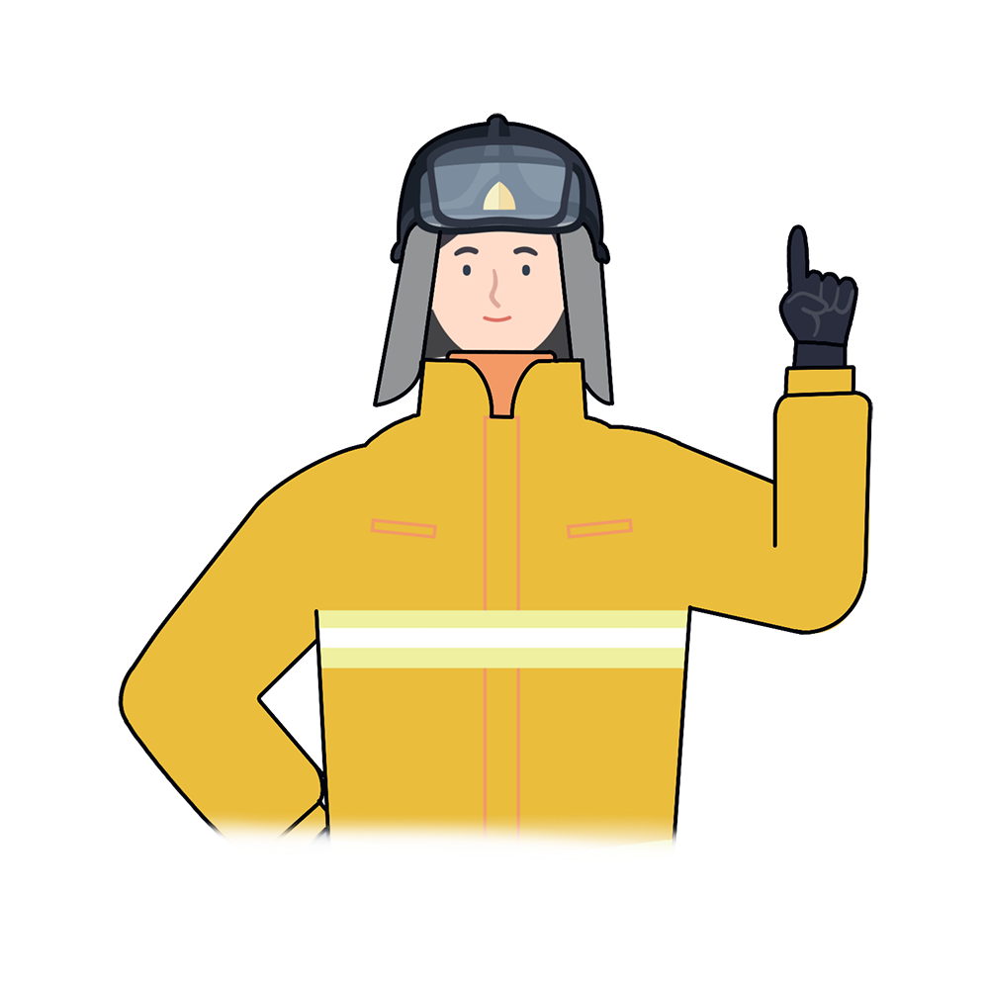
4
Procedure of 119 Reporting System
“
응급 의료
각종 재난
Immediately call 119
if an accident or fire occurs
Calmly open the phone and dial 3 numbers → ① ① ⑨ and inform the situation
대한민국 소방관
“
Late notice may cause more damage
Disabled
Woman
Elderly
Foreigner

Slide 7

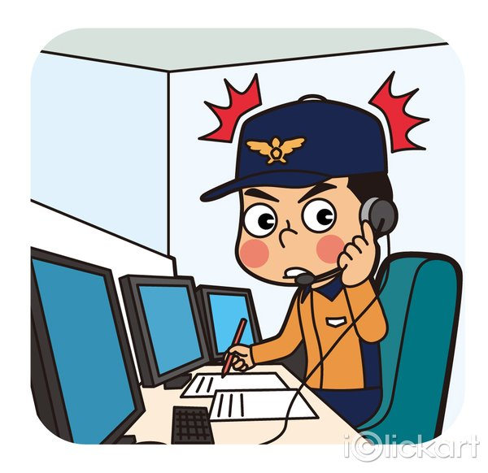
4
Procedure of 119 Reporting System
1. Call 119 and inform the situation and its
address accurately
2. Answer more questions from staff
(Cause of the accident,
number of injured people, etc.)
Disabled
Woman
Elderly
Foreigner

Slide 8

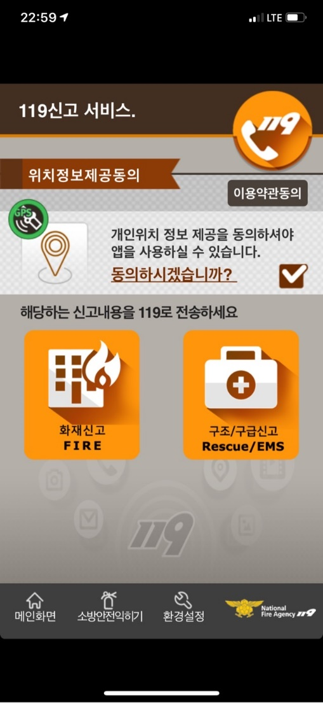
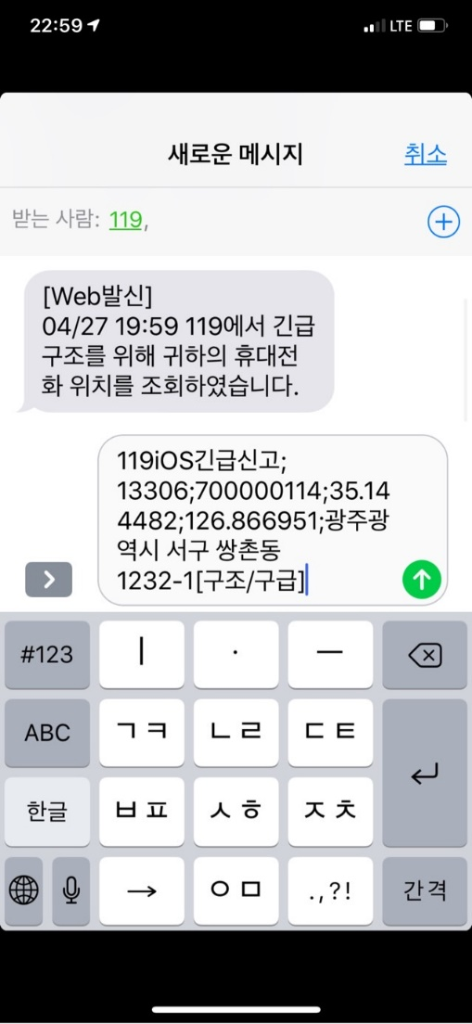
4
Procedure of 119 Reporting System
응급 의료
각종 재난
Disabled
Woman
Elderly
Foreigner

Slide 9
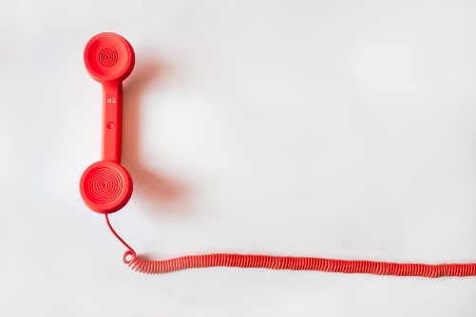
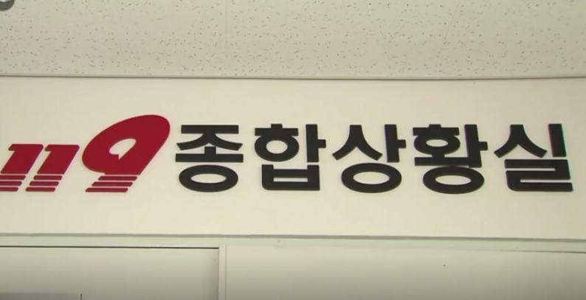
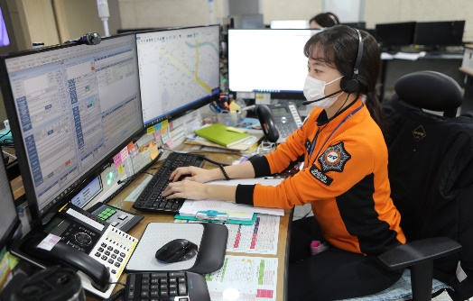
4
Procedure of 119 Reporting System
응급 의료
각종 재난
① ① ⑨
Dial 119
Contact the general
information room
Check location and equipment
Automatic telephone number
identification (ANI)
Geographic information system
(GIS)
Departure to the scene from the nearest fire department
Disabled
Woman
Elderly
Foreigner

Slide 10
4
Procedure of 119 Reporting System
Dial 119
(If one does not speak Korean)
Information service
Connect to the 119 Integrated Situation Office
Check accident scene through GIS system
Rescue vehicles are automatically allocated depending on the situation information
Disabled
Woman
Elderly
Foreigner

Slide 11
*
Key Points for Fire Safety
“
The fire service organization in Korea
always tries its best to develop plans for rescue, emergency and timely prevention in various accidents and natural disaster.
Don't forget to call 119 to save your life
and those around you!
“
Disabled
Woman
Elderly
Foreigner

Slide 12

Role of Fire Departments
Fire safety training is the foundation for a safe society and happy people

