Slide 1
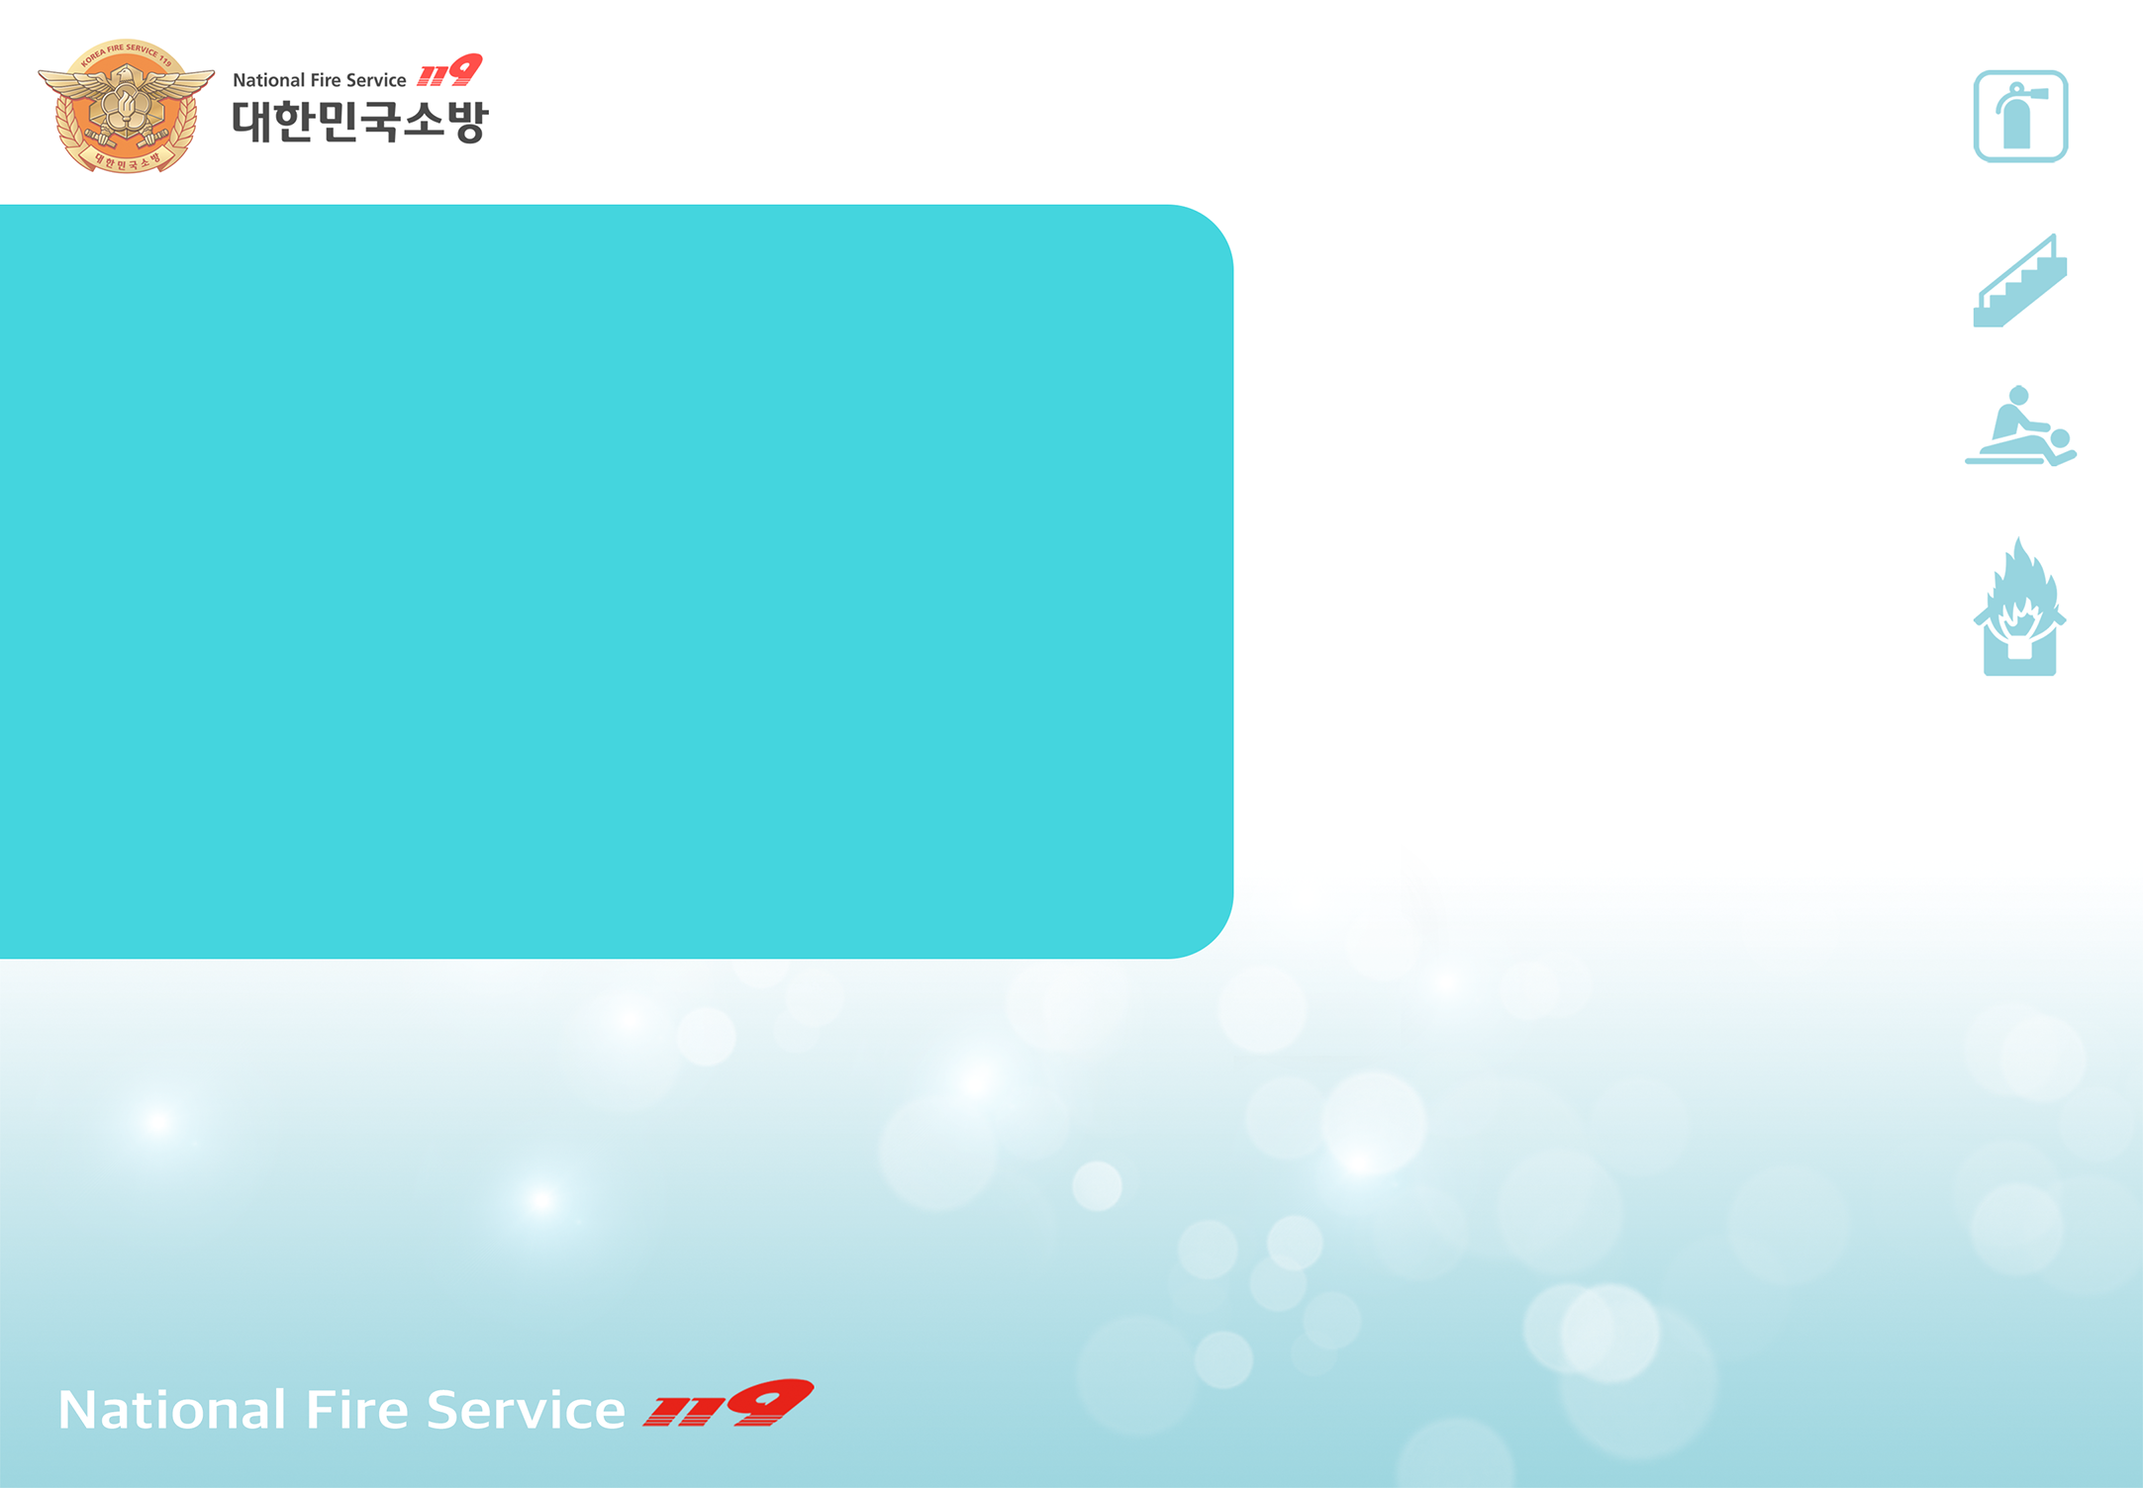
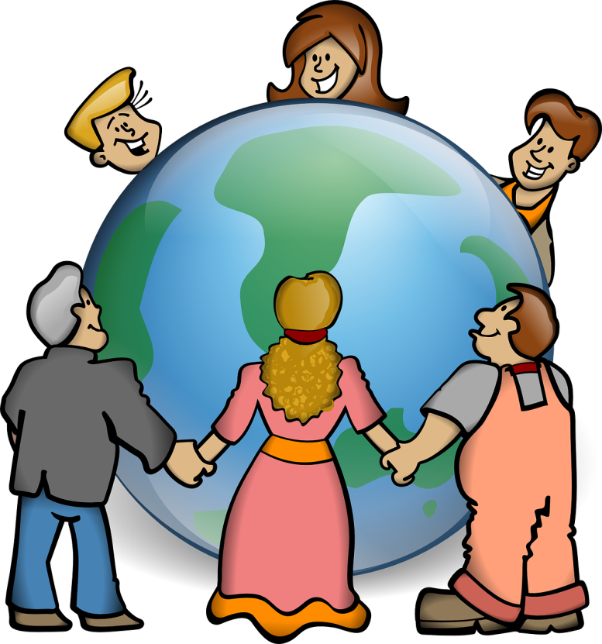

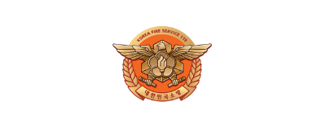




[Episode.2]
Korean Words
For Emergency
Situations
Disabled
Woman
Elderly
Foreigner

Slide 2


Contents
[Episode.2]
Korean Words for Emergency Situations
1. Korean Words for Emergency Situations_ 2p
2. Actions Upon Detecting A Fire_ 5p
3. Call 119_ 6p
Disabled
Woman
Elderly
Foreigner

Slide 3

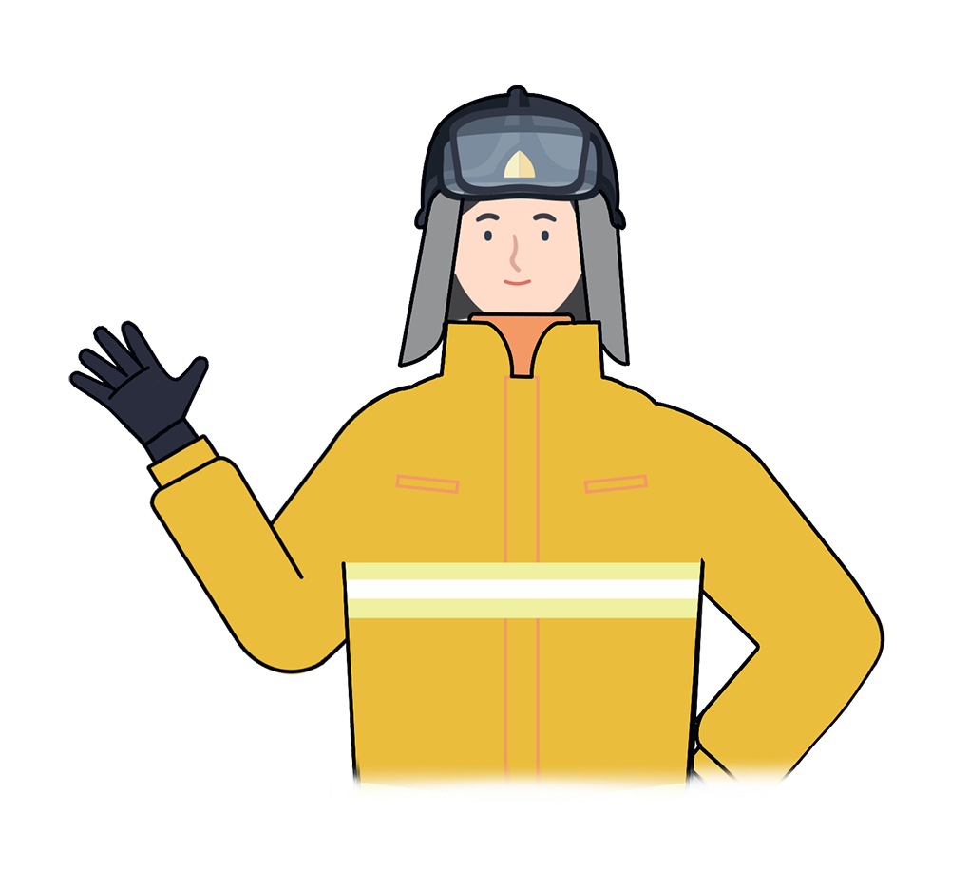
1
Korean Words for Emergency Situations
“
In October 2018 during a fire from the a house in Kyung Nam, almost everyone was able to escape after hearing the shout “ Bul i ya ~ !! "
except for a foreigner who didn’t understand the meaning of the phrase. We need to know basic Korean expressions related to fires and natural disasters to use in an emergency
“
Disabled
Woman
Elderly
Foreigner

Slide 4
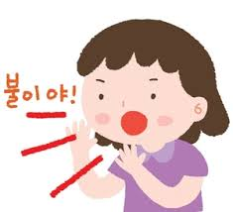
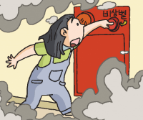
1
Korean Words for Emergency Situations
Remember the sentence - “Bul i ya” when there's a fire
If you can’t say this sentence or miss the opportunity to do so, you may lose your chance to live
Bul i ya
1. “Bul i ya~!!” Scream to announce a fire to everyone
2. “Daepihaseyo~!!” Scream to announce the escape exit to everyone
Disabled
Woman
Elderly
Foreigner

Slide 5
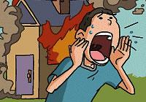
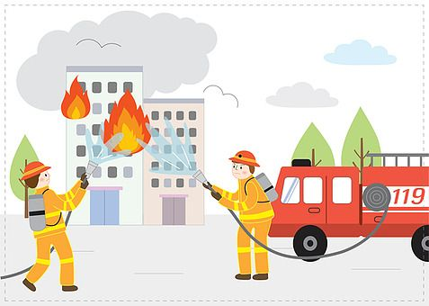
1
Korean Words for Emergency Situations
3. “Do oa chu se yo~!!” Scream for rescue
4. “Mu sưn il i e yo? “ / “Cham kam man ki ta ryo
chu se yo~”
Words that help when calling 119
Disabled
Woman
Elderly
Foreigner

Slide 6
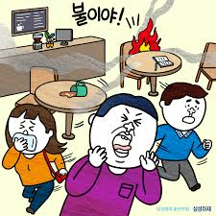
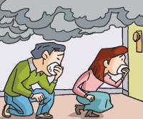
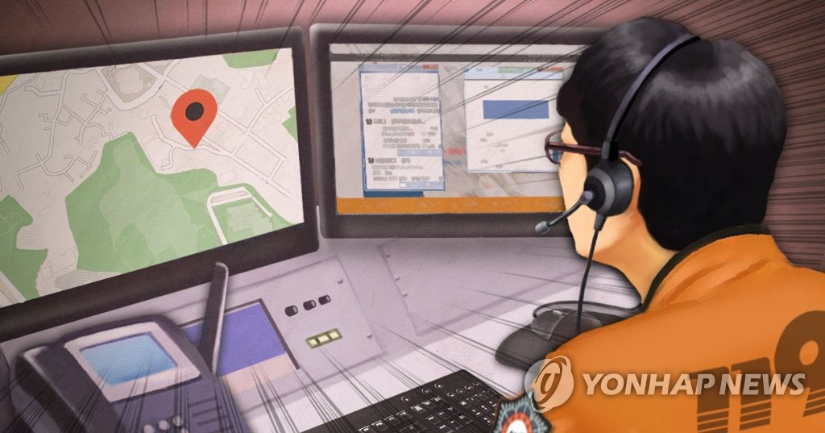
2
Actions Upon Detecting A Fire
1.“Bul i ya!” Scream to announce a fire
2. Evacuate to a safe place through exits
3. Call 119
upon reaching a safe place
Disabled
Woman
Elderly
Foreigner

Slide 7
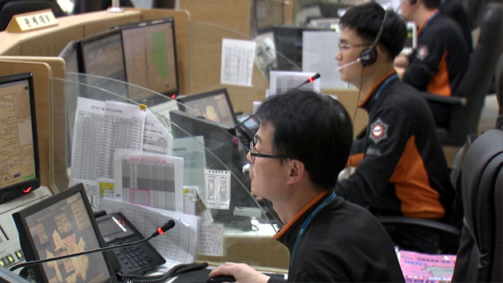
3
Call 119
Call 119 when one doesn’t speak Korean
1. Connect to a third-party interpreter service through the interpreter service provider
2. Video call / Call 119 by app
Disabled
Woman
Elderly
Foreigner

Slide 8
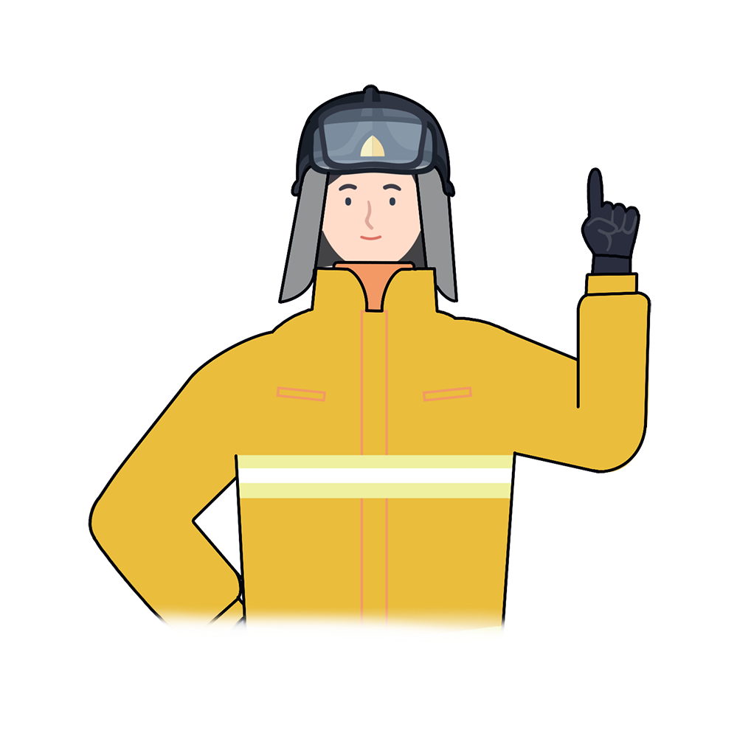
*
Key Points for Fire Safety
“
It is necessary to know the phrases needed for survival to use in case of fires or natural disasters.
Don't forget that it takes just one Korean phrase in an emergency to save the lives of you, your loved ones and those around you.
“
Disabled
Woman
Elderly
Foreigner

Slide 9

Korean Words For Emergency Situations
Fire safety training is the foundation for a safe society and happy people

