Slide 1








[Episode.6]
Risk of Oil Fires
Disabled
Woman
Elderly
Foreigner

Slide 2



Contents
[Episode.6]
Risk of Oil Fires
1. Statistics on Oil Fires _ 2p
2. Risk of Petrol Heater_ 5p
3. Safety Rules for Oil Use _ 6p
Disabled
Woman
Elderly
Foreigner

Slide 3


1
Statistics on Oil Fires
“
At 11am on October 7, 2019
At Goyang petrol station in Goyang province
A fuel tank exploded, causing a major fire
The fire spread widely and caused anxiety in the public (property damage of 4.3 billion won, no casualties)
Let’s analyze the gasoline fire risk as well as the regulations on petrol safety.
“
Disabled
Woman
Elderly
Foreigner

Slide 4
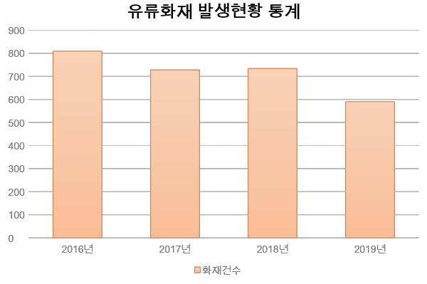
1
Statistics on Oil Fires
Statistics on the Occurrence of Oil Fires
2016
2017
2018
2019
The Number of Fires
National Fire Data System(www.firedata.go.kr), Statistics on the Occurrence of Oil fires
Disabled
Woman
Elderly
Foreigner

Slide 5
1
Statistics on Oil Fires
In a fire caused by gasoline in Suwon, three people suffered severe burns
Use of a petrol heater caused a fire at a restaurant
At a restaurant in Kwon Son district of Suwon city, a fire broke out and it took 20 minutes for the fire to be extinguished.
The fire resulted in three people injured all over their bodies and legs and immediately taken to the hospital
News 2019.1.14.
At a restaurant in SeongNam province, a petrol heater killed a 50-year-old woman.
The cause of the fire was a person opened the petrol heater that caused the fire to ignite with the oil.
MBC 2018.3.27.
Disabled
Woman
Elderly
Foreigner

Slide 6
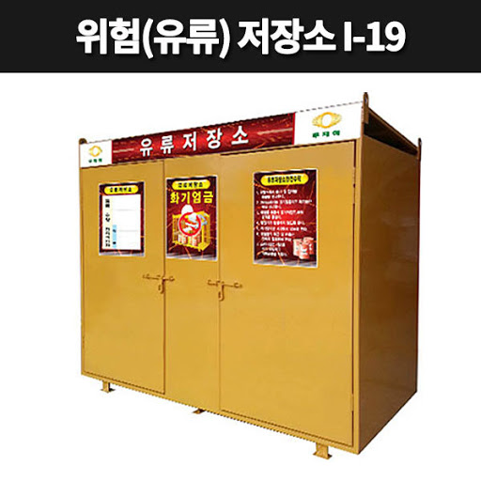
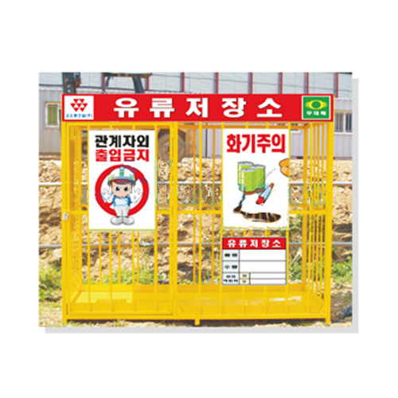
1
Risk of Petrol Heater
2
Use a petrol heater safely
Check the oil gauge if there is petrol inside before using it
Check for flammable objects around
Adjust the fire so that the device does not overheat during use
Frequently check so that the engine does not overheat
Turn off the engine and wait for the heat to cool before refueling
Disabled
Woman
Elderly
Foreigner

Slide 7
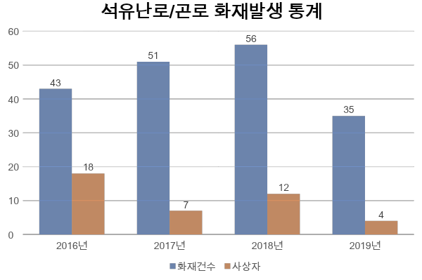
1
Risk of Petrol Heater
2
Petrol heater and Oil stove fire occurrence statistics
2016
2017
2018
2019
2016
2017
2018
2019
Number
of Fires
Casualties
National Fire Data System(www.nfds.go.kr), / Petrol heater, Oil Stove Fire Occurrence Statistics
Disabled
Woman
Elderly
Foreigner

Slide 8
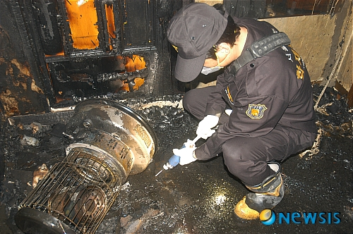
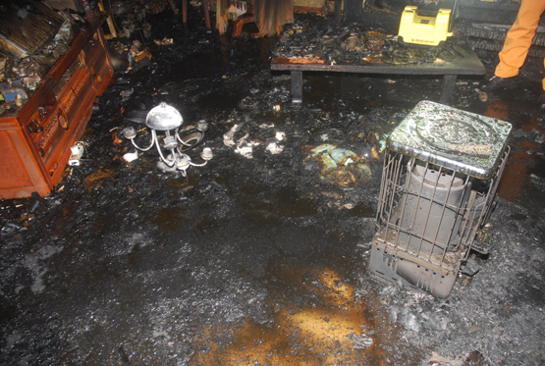
3
Safety Rules for Oil Use
Care should be taken when turning on gasoline-powered appliances such as petrol heaters for a long time as they may cause an explosion
Turning off the power of devices is the cause of fire and suppressing the flame.
In no circumstances one should use water to extinguish the fire
Disabled
Woman
Elderly
Foreigner

Slide 9
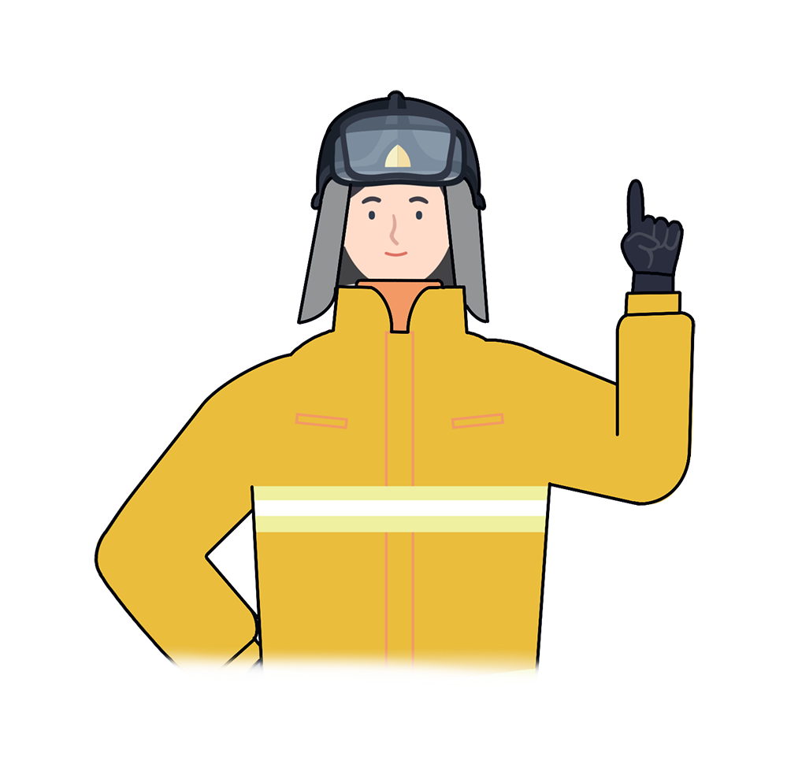
*
Key Points for Fire Safety
“
Any fire caused by gasoline is often a big fire because the gasoline particles disperse into the air like dust particles and easily spread.
Comply with safety rules and instructions when using gasoline-fueled appliances and fixtures
“
Disabled
Woman
Elderly
Foreigner

Slide 10

Risk of Oil Fires
Fire safety training is the foundation for a safe society and happy people

